Slide 1


Student Schedule Organizer Team-9
ThePhoto by PhotoAuthor is licensed under CCYYSA.
Authors: Muhammad Jahanzaib
Youhana Ghandali
Swati Mehta
Jatin Vig

Slide 2
Introduction
Managing coursework efficiently is a challenge for students, especially when handling multiple assignments from different courses. The built-in D2L To-Do list lacks advanced features like custom sorting, categorization, and calendar integration, making it difficult to track deadlines effectively.
The Student Schedule Organizer simplifies task management by allowing students to: Manually add assignments from D2L View tasks in a calendar or to-do list format Prioritize assignments based on due dates and importance
This tool enhances productivity and reduces workload stress, ensuring students never miss a deadline!
Notes:
1. introduce the project 🔹Good afternoon everyone! Today, I am excited to present our project, the Student Schedule Organizer. Our team Youhana, Swati, Jatin, and myself, Muhammad developed this tool to help students manage their coursework more efficiently.
2. Explain the problem students face 🔹 As students, we often struggle with organizing assignments, tracking deadlines, and balancing different tasks. As we know, the existing tools, like the D2L To-Do list, are limited they don’t offer features like custom sorting, categorization, or calendar integration. This makes it hard to stay on top of everything.
3. Introduce the solution – Student Schedule Organizer 🔹 "Our project solves this by providing a simple and effective way to manage assignments. Students can manually add tasks, view them in a calendar or to-do list format, and prioritize assignments based on due dates and importance. This way, they can always focus on what matters most."
4. Highlight key benefits 🔹 With this tool, students will be able to reduce stress, stay organized, and improve productivity. By integrating features that D2L lacks, we ensure that managing coursework becomes more efficient and less overwhelming.

Slide 3
Team Roles
Project Manager: Swati Mehta
Project Facilitator: Youhana Ghandali
Documentation Lead: Jatin Vig
Technical Lead: Muhammad Jahanzaib

Slide 4
Primary Functions
Take in user-given events and tasks through our simple and compact GUI.
Calendar view of current and upcoming weeks with the entered tasks.
List view of all the tasks entered by the user.
User may include a description for the added tasks.(extra feature).
Simple button for when you complete a task.(extra).

Slide 5
Secondary Function
🔧 Secondary Functions
✨ Extra Features
Dark/Light Mode Toggle
Switch between light and dark themes for a personalized experience.
Task History Window
View all previously completed tasks in one place.
Priority Levels with Color Coding
High | Medium | Low visually highlights task importance.
Custom Login System User-friendly login with Student ID, Name, and Password. (saves in credentials.txt)
Course Information Storage Automatically saves course-related details for each task in a CSV file.
Task Prioritization Tasks can be sorted by priority and due date to show the most urgent ones first.
Task Deletion
Easily delete mistakenly added tasks.
Editable List View
Edit task details directly in the list interface.
Notes:
So our customer provided us three secondary functions , mainly d2l integertion, course storage, and priotiation

Slide 6
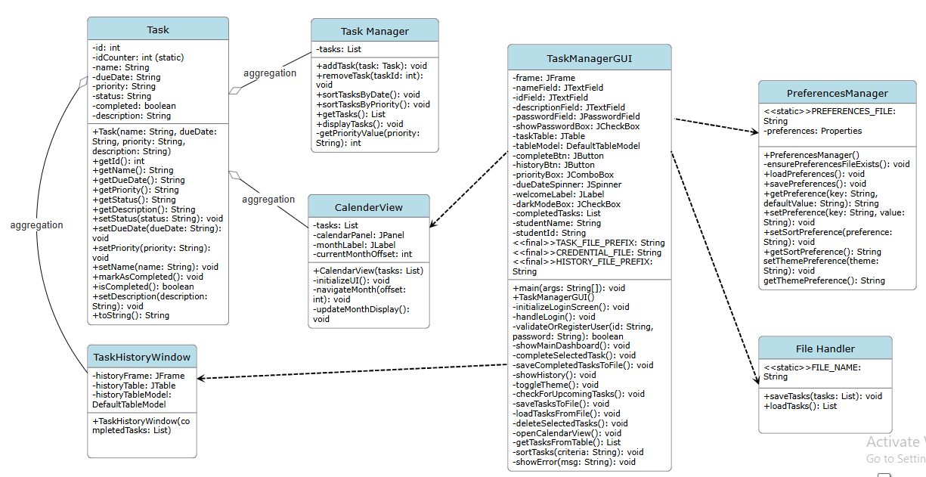
UML Diagram
The UML Class Diagram represents the structure and relationships of key components in our Student Schedule Organizer project.
Key components include:
Task & TaskManager: Handles task creation, editing, and sorting.
TaskManagerGUI: Manages user interactions and the graphical interface.
CalendarView: Displays tasks in a monthly format.
FileHandler & PreferencesManager: Manage data persistence and user settings.
TaskHistoryWindow: Displays completed tasks for reference.
Notes:
1. Introduce the UML Diagram 🔹 "This diagram represents the structure of our Student Schedule Organizer. It shows how different parts of the system interact to help students manage their tasks and schedules efficiently."
2. Explain Key Classes Briefly 🔹 "The Task class represents individual tasks, with details like due date and priority. The TaskManager keeps track of all tasks, sorting them by date or priority. The TaskManagerGUI is the main interface where users can add, edit, and view their tasks."
🔹 "To help with scheduling, the CalendarView displays tasks in a monthly format, making it easier to plan ahead. The TaskHistoryWindow keeps track of completed tasks so users can review their past work. The FileHandler ensures that tasks are saved and loaded properly, while the PreferencesManager allows users to customize settings like sorting preferences and themes."
3. Highlight Relationships 🔹 "The TaskManager stores and organizes multiple tasks, while the GUI connects everything, allowing users to interact with the system easily. The CalendarView and TaskHistoryWindow display important information, and the FileHandler ensures data is not lost. All these components work together to create a smooth task management experience."

Slide 7

Key Design Principles Followed:
Single Responsibility
Classes like Task, PreferencesManager, and FileHandler do one thing well.
Model-View-Controller (MVC).
Swing GUI, data (Task, FileHandler), and logic (TaskManagerGUI) are well-separated for better maintainability
Interface Segregation Principle
Each class in our system handles a specific aspect
Notes:
Model → Classes like Task, FileHandler manage the data.
View → Swing-based GUI components are the user interface.
Controller → TaskManagerGUI controls how data and interface interact.

Slide 8
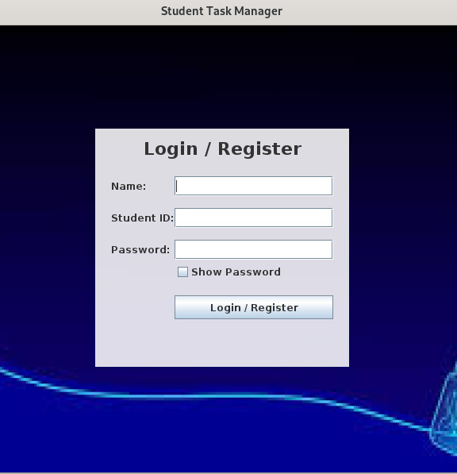
Demo

Slide 9


Thank you!

